Slide 1


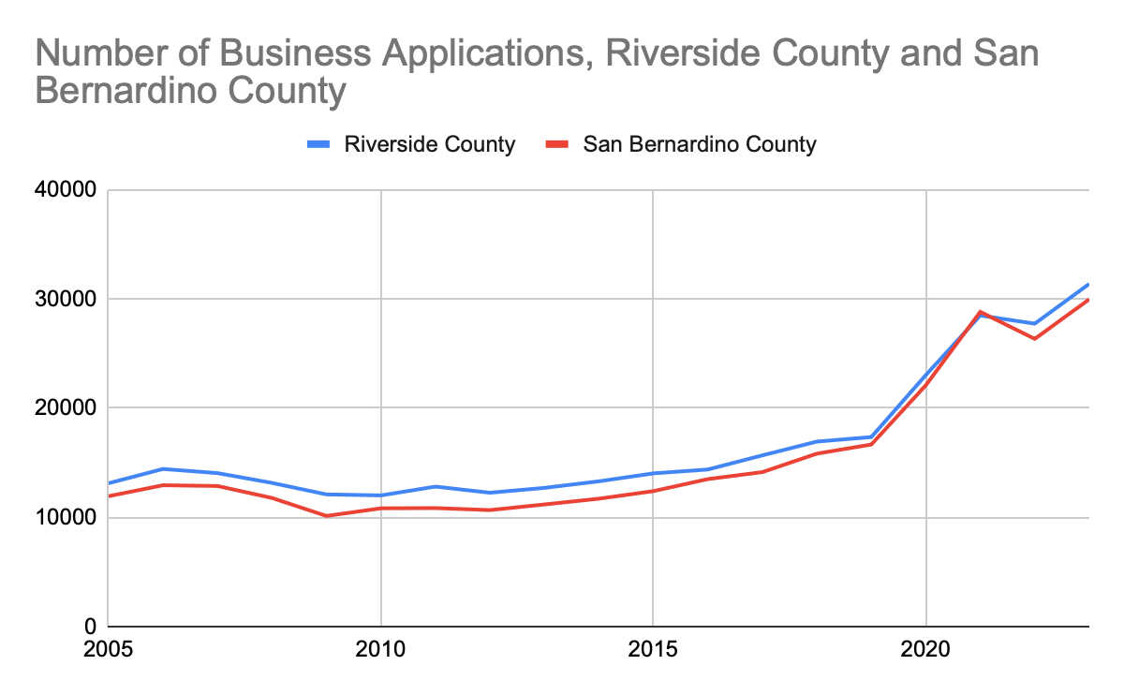



Entrepreneurial Ecosystem for high-growth startups & main street businesses
Strategies and tactics
Improve access to funding and capacity-building programs for historically underrepresented groups facing barriers: Offering tailored capacity-building initiatives and skills development opportunities can better meet the needs of entrepreneurs from historically underrepresented communities.
Improve access to mentorship, training programs, and networking opportunities, especially for small business owners from historically underrepresented groups: Improve access to mentorship, training programs, and networking opportunities for small business owners from historically underrepresented groups.
Tailor funding initiatives, mentorship programs, training programs, and other entrepreneur supports to meet the needs of historically underrepresented entrepreneurs: Designing programs with historically underrepresented entrepreneurs in mind can help address barriers that hinder their ability to start, sustain, and grow successful businesses.
Promote co-ops to enhance the entrepreneurial ecosystem for high-growth startups and Main Street businesses owned by individuals from equity-seeking groups: Co-ops provide shared resources, democratic decision-making, and mutual support, improving access to capital, training, and market reach while fostering community engagement and resilience.
Showcase success stories from historically underrepresented entrepreneurs in the region in order to provide examples and role models for others to follow: Highlighting these success stories will inspire and motivate new entrepreneurs, demonstrating the potential for business growth and community impact.
Why is this topic important?
Developing an inclusive entrepreneurial ecosystem aims to support high-growth startups and Main Street businesses, particularly those led by underrepresented entrepreneurs, by providing tailored programs, funding initiatives, mentorship, financial literacy, and networking opportunities to foster innovation, job creation, and economic growth in the region.
Why is an entrepreneurial ecosystem for high-growth startups and main street businesses important for a strong and inclusive regional economy?
A strong entrepreneurial ecosystem is a vital component of any inclusive regional economic development strategy. When entrepreneurs start new companies, they also create jobs, new business for suppliers, and new products and services for potential customers. Making it easier for would-be entrepreneurs to develop their ideas and launch their companies means more economic activity for the region and a chance at wealth-building for company founders. This is especially true for those from historically underrepresented groups that were systematically excluded from entrepreneurial opportunities in the past.
How will an entrepreneurial ecosystem for high-growth startups and main street businesses contribute to a more equitable Inland SoCal?
This strategy offers significant equity impact potential by ensuring that historically underrepresented entrepreneurs have access to tailored programs, funding, mentorship, financial literacy, and networking opportunities, aiming to dismantle barriers that have historically limited their entrepreneurial success. Providing targeted support such as financial management training, marketing skills, and business planning workshops ensures that these entrepreneurs are well-equipped to start and grow their businesses. Ultimately, fostering diverse entrepreneurial talent strengthens the regional economy, making it more dynamic and competitive, and ensures that all residents of Inland Southern California have the opportunity to contribute to and benefit from economic prosperity.
What we have heard from the community…
Key data findings…
Ede^{[1]} spoke at length about the impact resources aimed at small business owners can have. They described, “My wife is an at home baker. She went to the Small Business Development Center to get the education on how to do it. I'll lay out a business plan, you know, ask for loans and all that stuff. And there's resources, and we'll be sharing those resources, providing an avenue of education . . . that, hopefully, empowers our business owners . . . And so she sells to other coffee shops. So she does business-to-business sales. And that's all because of the programs that are available through you know, the Small Business Development Center, the Inland Empire Women's Business Center. She does a lot of workshops. There's just a lot of resources that people don't know about.”
Some individuals may prefer to start their own businesses rather than seeking traditional employment. Entrepreneurship support programs offer training, mentorship, and access to resources to help aspiring entrepreneurs launch and grow successful businesses.
Develop local technology and innovation industries and attract high-tech enterprises and talents. Provide start-up loans and financial support to help residents who are willing to start businesses. Establish and develop eco-tourism and cultural and creative industries to provide more job opportunities.
https://www.census.gov/econ/bfs/data/county.html

Slide 2

TOPIC (Economic Mobility and Wealth-Building)
Strategies and tactics
INSERT TEXT
Why is this topic important?
INSERT TEXT
What we have heard from community?
Key data findings…
INSERT TEXT / QUOTES
INSERT GRAPH(S) / TEXT

